Slide 1
Natural Language Processing
Under the supervision of:
Dr. H.S. Behera
Professor
Department of Information Technology
VSSUT, BURLA
Presented By:
Vivek Kejriwal

Slide 2
Outlines
What is NLP?
Levels of Linguistic Knowledge
Why NLP is hard?
Applications of NLP
Future Scope
Conclusion
References

Slide 3
What is NLP?
NLP is a way for computers to analyze, understand, and derive meaning from human language in a smart and useful way. By utilizing NLP, developers can organize and structure knowledge to perform tasks such as automatic summarization, translation, named entity recognition, relationship extraction, sentiment analysis, speech recognition, and topic segmentation.
NLP is used to analyze text, allowing machines to understand how humans speak. This human-computer interaction enables real-world applications like automatic text summarization, sentiment analysis, topic extraction, named entity recognition, parts-of-speech tagging, relationship extraction, stemming, and more.

Slide 4
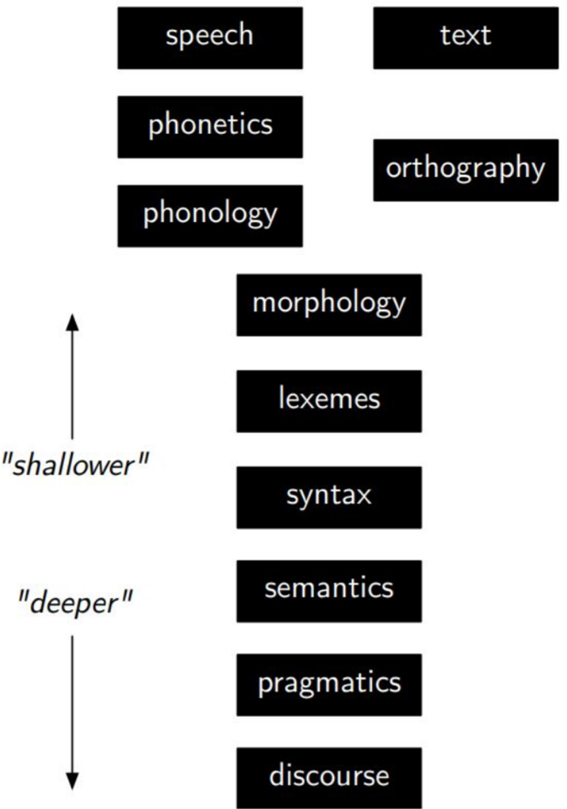
Levels of Linguistic Knowledge

Slide 5
Why NLP is hard?
Ambiguity
Scale
Sparsity
Variation
Expressivity
Unmodeled Variables
Unknown representations

Slide 6

Ambiguity
Ambiguity at multiple levels
Word senses: bank (finance or river ?)
Part of speech: chair (noun or verb ?)
Syntactic structure: I can see a man with a telescope
Multiple: I made her duck

Slide 7
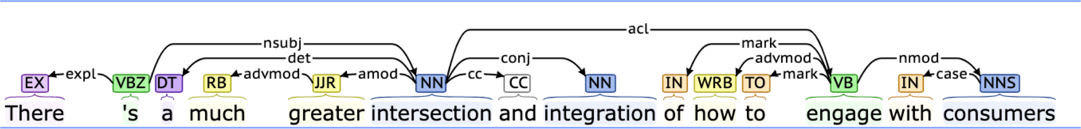
Variation
Suppose we train a part of speech tagger or a parser on the Wall Street Journal
What will happen if we try to use this tagger/parser for social media
“ikr smh he asked fir yo last name so he can add u on fb lololol”

Slide 8

Expressivity
Not only can one form have different meanings (ambiguity) but the same meaning can be expressed with different forms:
She gave the book to Tom vs. She gave Tom the book
Some kids popped by vs. A few children visited
Is that window still open? vs. Please close the window

Slide 9
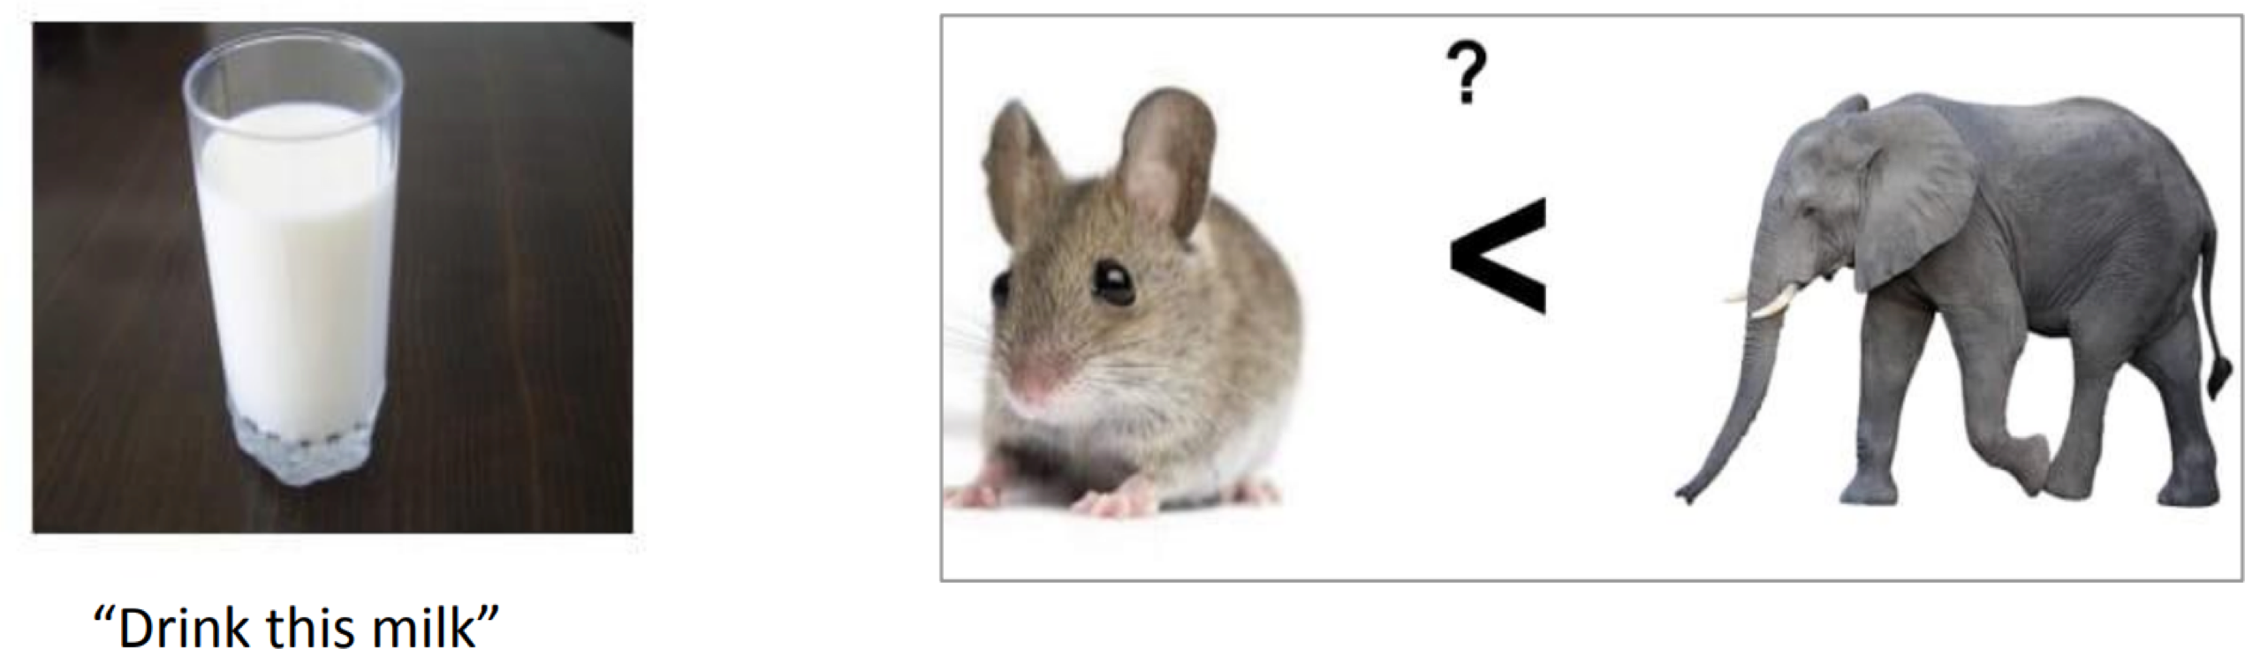
Unmodeled Variables
World knowledge
I dropped the glass on the floor and it broke
I dropped the hammer on the glass and it broke

Slide 10
Unmodeled Representation
Very difficult to capture what is !,since we don’t even know how to represent the knowledge a human has/needs:
What is the “meaning” of a word or sentence?
How to model context?
Other general knowledge?

Slide 11
Applications of NLP
Conversational agents
Information extraction and question answering
Machine translation
Opinion and sentimental analysis
Social media analysis
Visual understanding
Essay Evaluation
Mining legal, medical or scholarly literature

Slide 12
Future Scope
The Bots
Frequently used in customer service, especially in banking, retail and hospitality, chatbots help customers get right to the point without the wait, answering customer questions and directing them to relevant resources and products at any hour, any day of the week.
To be effective, chatbots must be fast, smart and easy to use, especially in a customer service context where users have high expectations (and sometimes low patience) for being understood. To accomplish this, chatbots employ NLP to understand language, usually over text or voice-recognition interactions, where users communicate in their own words, as they would speak to an agent.
Integration with semantic and other cognitive technologies that enable a deeper understanding of human language will allow chatbots to get even better at understanding and replying to more complex and longer-form requests and functions in more than a single context, all in real time.

Slide 13
Conclusion
NLP supposedly makes the job easier but still demands a human interference. People and the industry fear NLP would start a trend of job snatching which is true to a certain sense but it certainly cannot function the way it does without human inputs. The will to work and cater to the loopholes or bugs in a machine is the task of a human who is handling it. Notwithstanding, the advantages of NLP may anger in the arena of jobs but right now it is the knight in the shining armor of the industry. While NLP is a relatively recent area of research and application, as compared to other information technology approaches, there have been sufficient successes to date that suggest that NLP-based information access technologies will continue to be a major area of research and development in information systems now and far into the future.

Slide 14
References
Natural Language Processing: State of The Art, Current Trends and Challenges Diksha Khurana, Aditya Koli, Kiran Khatter, Sukhdev Singh
Jurafsky and Martin, Speech and Language Processing, 2nd or 3rd Edition https://web.stanford.edu/~jurafsky/slp3/
Eisenstein, Natural Language Processing https://github.com/jacobeisenstein/gt-nlp-class/blob/master/notes/eisenstein-nlp-notes.pdf
www.cc.gatech.edu/classes/AY2020/cs7650_spring/

Slide 15
Thank You!

